Slide 1

Capstone Project 1
Hotel Booking Analysis Team Members: Rohith V Abhishek V L Nikita Hubballi Aditi Sharma

Slide 2
Contents
Introduction
Work Overflow
Data Understanding
Data cleaning and handling of missing values
Data Processing
Problem Statement
Correlation Heatmap
Performing EDA
Conclusion

Slide 3
Introduction
The hotel industry is one of the most important components within the service industry, catering for customers who require overnight accommodation. It is closely associated with the travel industry and the hospitality industry, although there are notable differences in the scope.
Overall, sales from hotel accounts 87.4% of the hotel industry revenue (in India 53.9% and 8% total employment rate)
In tourism and travel related industries, most of the research on Revenue Management demand forecasting and prediction problems employ data from the aviation industry, in the format known as the Passenger Name Record (PNR).

Slide 4
Work Overflow
Work is divided into three steps:
Step 1→ Data Collection and Understanding the data
Step 2→ Data cleanup and Handling the missing values
Step 3 → Performing EDA with the help of Visualizations

Slide 5
Types of EDA
EDA is basically Divided into 3 steps:
Univariate analysis: It is the simplest form of analyzing data. “Uni” means “one”, so in other words your data has only one variable. It doesn’t deal with causes or relationships and it’s major purpose is to describe; It takes data, summarizes that data and finds patterns in the data.
Bivariate analysis: It is a kind of statistical analysis in which two variables are observed against each other. One of the variables will be dependent, and the other is independent.
Multivariate analysis: Multivariate analysis is a more complex form of a statistical analysis technique and is used when there are more than two variables in the data set.

Slide 6
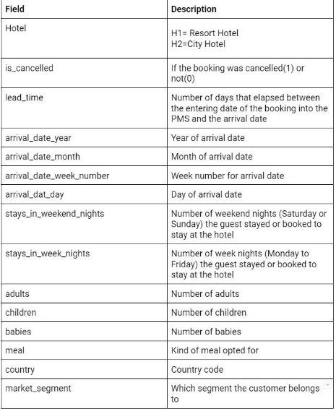
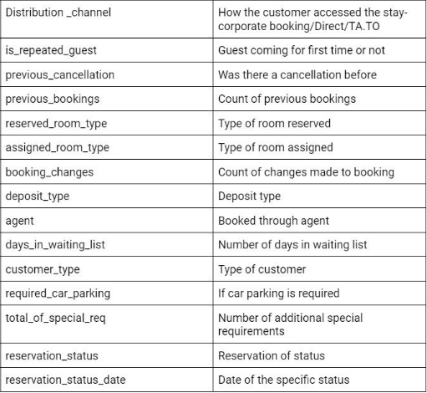
Data Understanding:
The dataset consists of 32 variables with 1,19,390 observations. The datasets comprehend bookings due to arrive between the 1st of July of 2015 and the 31st of August 2017.

Slide 7
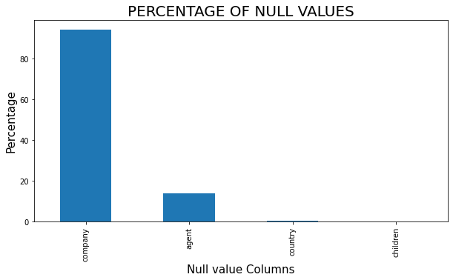
Data cleaning and handling of missing values
company - 94.307%
agent -13.686%
country - 0.409%
children - 0.003%
Handling of these Values:
Since the Company has got the
Highest percentage of Null values we
Dropped the entire column.

Slide 8
Data cleaning and handling of missing values
Agent column found to have
13% of the nulls, we just renamed
the Agent ID with “Agent” and
Null Agent values with “ No Agent”.
Since the country and children
column has got less than 1% of null
values, we replaced null value of
Country with “Undefined” and
Children with “0”.

Slide 9
Data Processing
In this stage, we checked for the duplicate values present in the data set.
We found out there were 32,014 duplicate data’s, So we removed all the duplicates which were present in it.
Finally our data has been cleaned with “No” null values present in it
Adding Two Extra Columns:
Total stay in hotel
Total Number of people

Slide 10
Problem Statement
In which of the hotel the highest booking was made
In which type of hotel people prefer stay in terms of days
Cancelation Done Based on months
High Cancelation rate in hotels
Arrival Seasonality based on years, months and days
Check whether the guest is repeated or not?
Which was the most preferred deposit type made
Mode of bookings through market segment and distribution channel
Majority stays in the hotel?
What type of meal preferred by the customer in each hotel
In which country the highest booking was made
What kind of visitors travelled more?
Which kind of rooms were assigned for different adult size

Slide 11
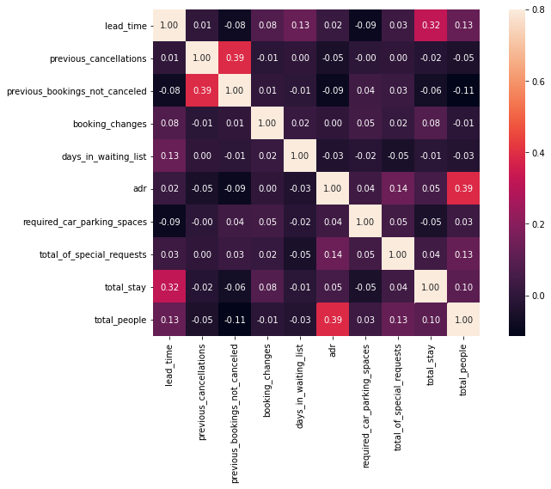
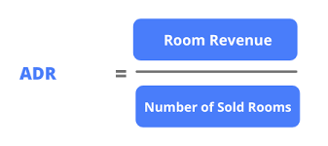
Correlation Heatmap:
We created a Heatmap Based on the
Numerical Data.
adr is slightly correlated with total_people,
which makes sense as more number of people
means more revenue, therefore more adr.
total stay and lead time have slight correlation.
This means that for longer hotel stays people
generally plan before the actual arrival.

Slide 12
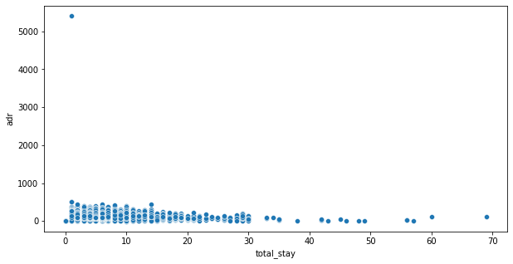
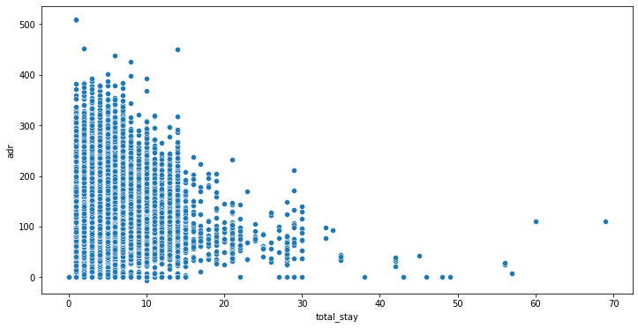
whether the length of stay effects the adr
Clearly we can see there is an outlier present in adr column
So we just removed that outlier.
This was the scatter plot after removing
the outlier.

Slide 13
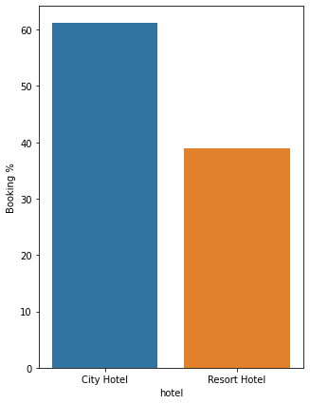
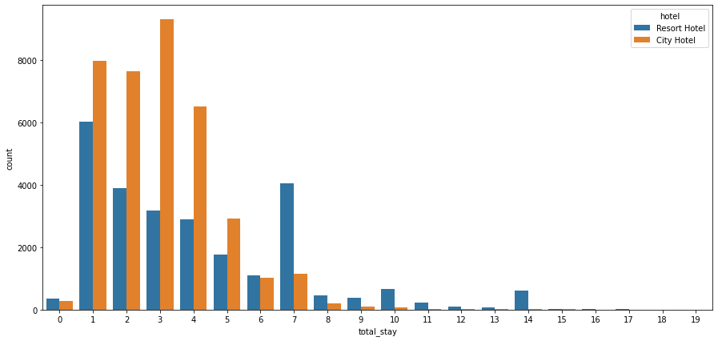
Performing EDA 1. EDA Based on Hotel
From the graph City hotel has nearly 60% of bookings done and Resort Hotels has got 40%. So city hotels are more preferred than resort hotels.
From the next graph, preference were made in city hotel for shorter duration stays and for longer duration stays resort hotel were preferred.

Slide 14
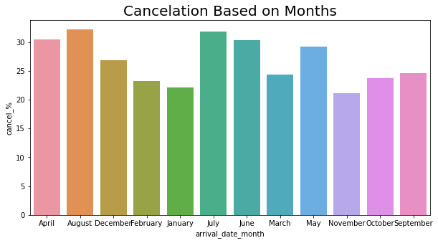
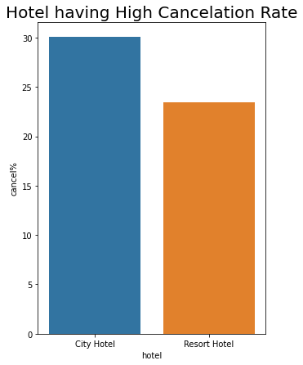
Performing EDA 2. EDA Based Cancelation Bookings
Here we can see cancelation percentage is done mostly in the month of july and august.
And city Hotel has the highest cancelation rate

Slide 15
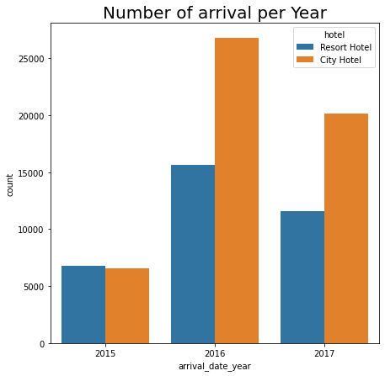
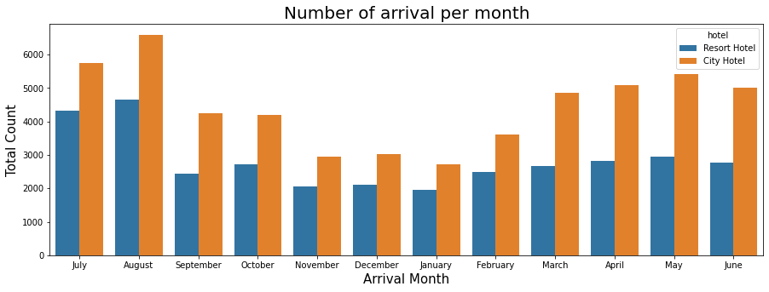
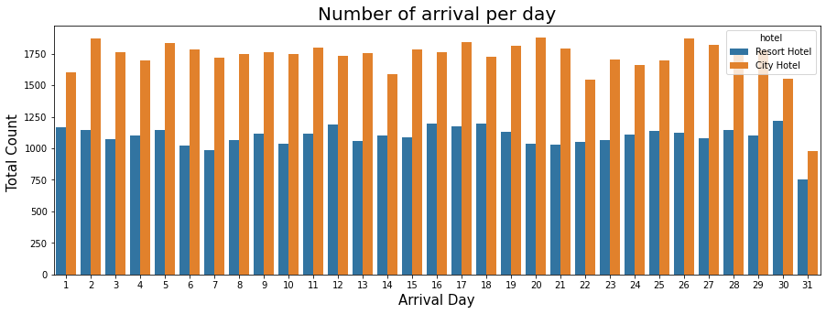
Performing EDA 3. EDA Based Arrival Period

Slide 16
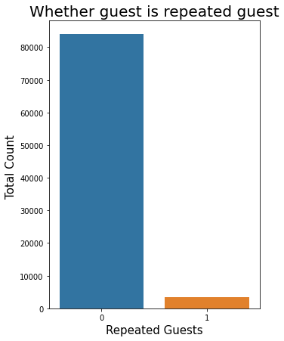
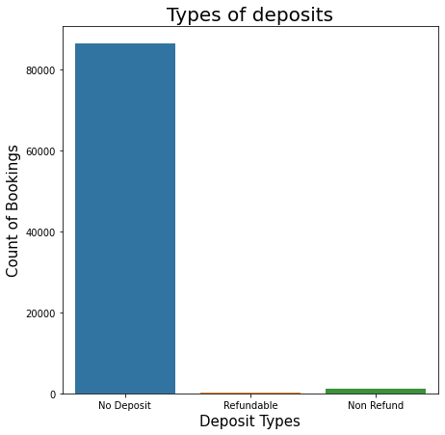
Performing EDA 4. EDA Based on Repeated guest and Deposit type

Slide 17
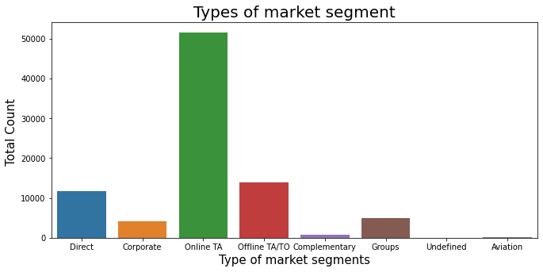
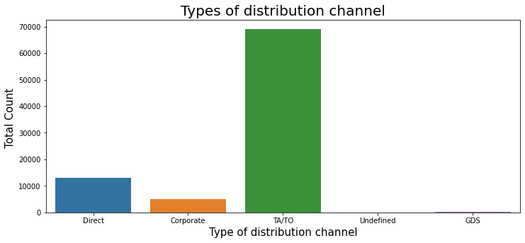
Performing EDA 5. EDA Based on Market segment and Distribution channel
We can target our marketing area to be on these travel agencies website and work with them since majority of the visitors tend to reach out to them.

Slide 18
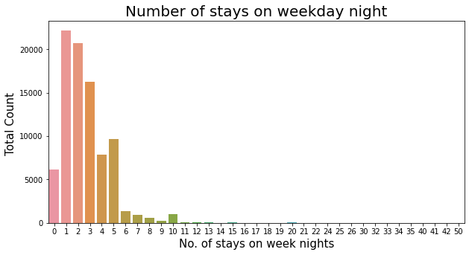
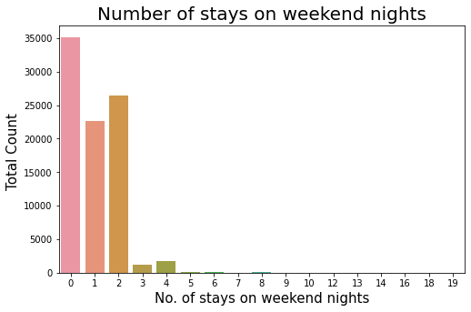
Performing EDA 6. EDA Based on Stays in Weekday and Weekend day Nights
From both the graphs, it seems that majority of the stays are over the weekday's night.

Slide 19
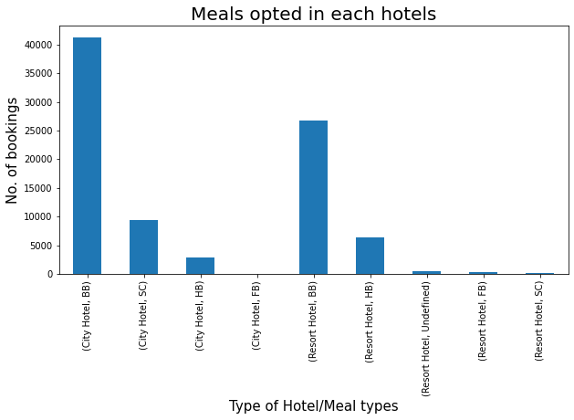
Performing EDA 7. EDA Based on Meals
People at each hotel can choose from four categories of meals which they can book their respective stays with, let's briefly see what those are
Undefined/SC – no meal package
BB – Bed & Breakfast
HB – Half board (breakfast and one
other meal – usually dinner)
FB – Full board (breakfast, lunch and
dinner)

Slide 20
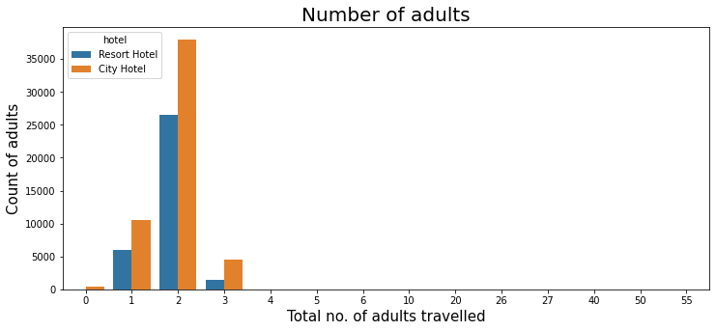
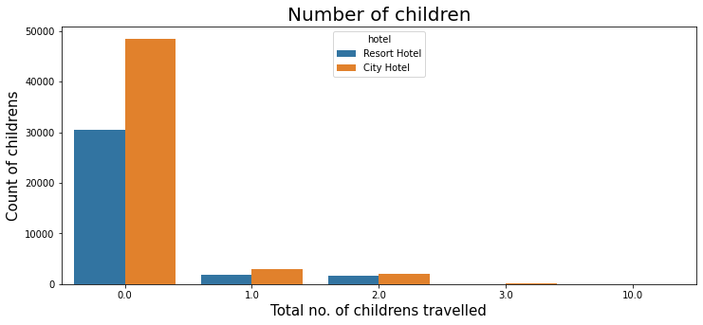
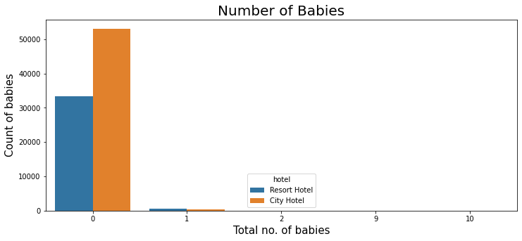
Performing EDA 8. EDA Based on Type of visitors
.

Slide 21
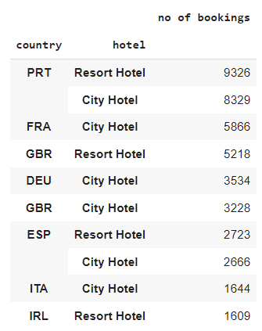
Performing EDA 9. EDA Based on Country
Clearly from the Data we can see Portugal (PRT) is
the top most county in bookings done for both city
and resort hotel, then followed by France (FRA)
then Great Britain (GBR)

Slide 22
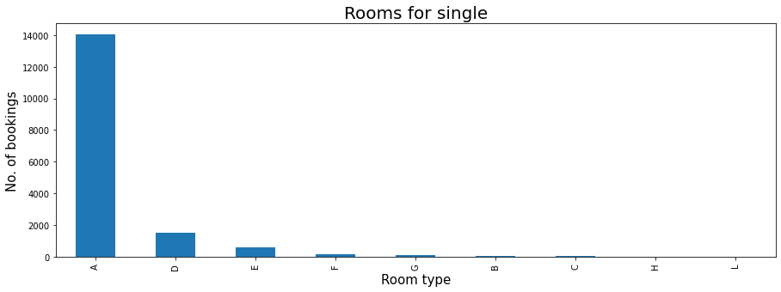
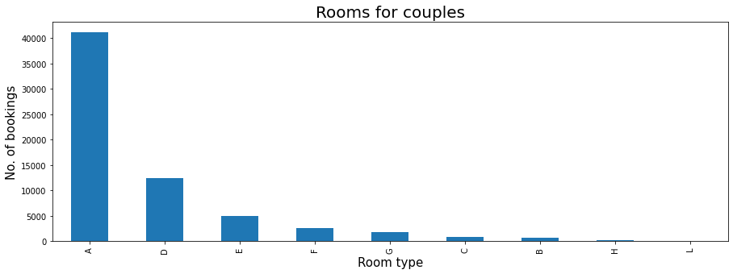
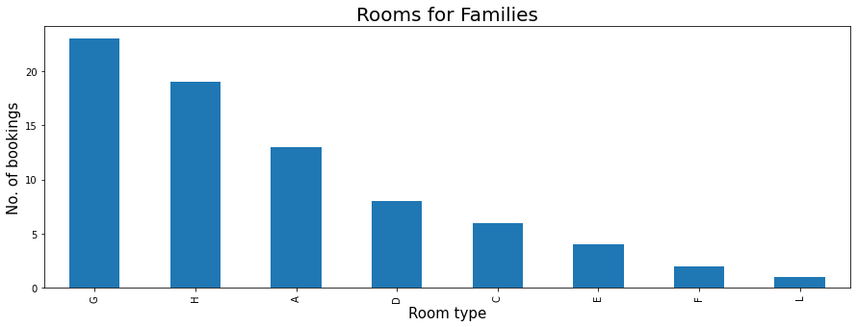
Performing EDA 10. EDA Based on Type of rooms
.

Slide 23
Conclusion
There was a lot of duplicate data.
Choosing appropriate visualization techniques to use was difficult.
A lot of null values were there in the dataset.
Since we were working with limited amount of data there is a pretty good chance of model decay in the future. To counter this, periodic remodelling and configuring of the model would be required.

Slide 24
THANK YOU

